Slide 2
objectives
Compute the eigenspectral of paint pigments from the Munsell Color Chips database
Convert a color camera into a spectral imager using principal components analysis
Color information is affected by light source, object spectral property, and sensor sensitivity.
Spectral information is a more stable descriptor of an object.
There is a variety pf hyperspectral databases available.
Converting spectral information into color is necessary for many reasons.

Slide 3
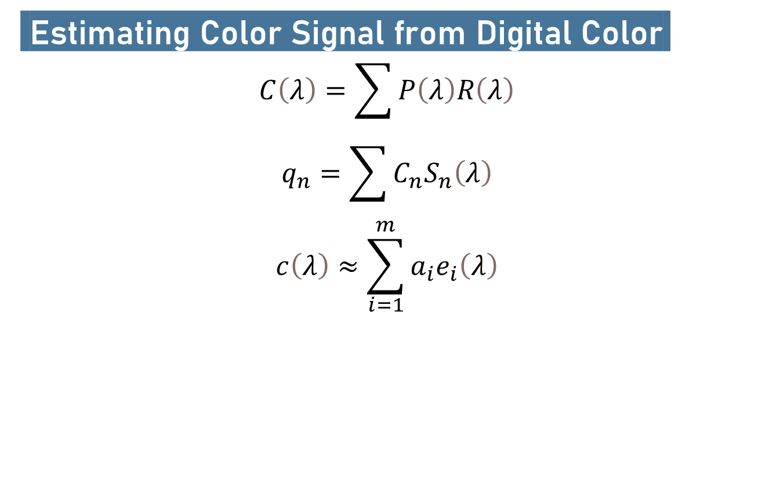
Methodology
Estimating Color Signal from Digital Color.
$$C\left(λ\right)=\sum{P\left(λ\right)R\left(λ\right)}$$
$$q_{n}=\sum{C_{n}S_{n}\left(λ\right)}$$
$$c\left(λ\right)≈\sum_{i=1}^{m}{a_{i}e_{i}\left(λ\right)}$$

Slide 4
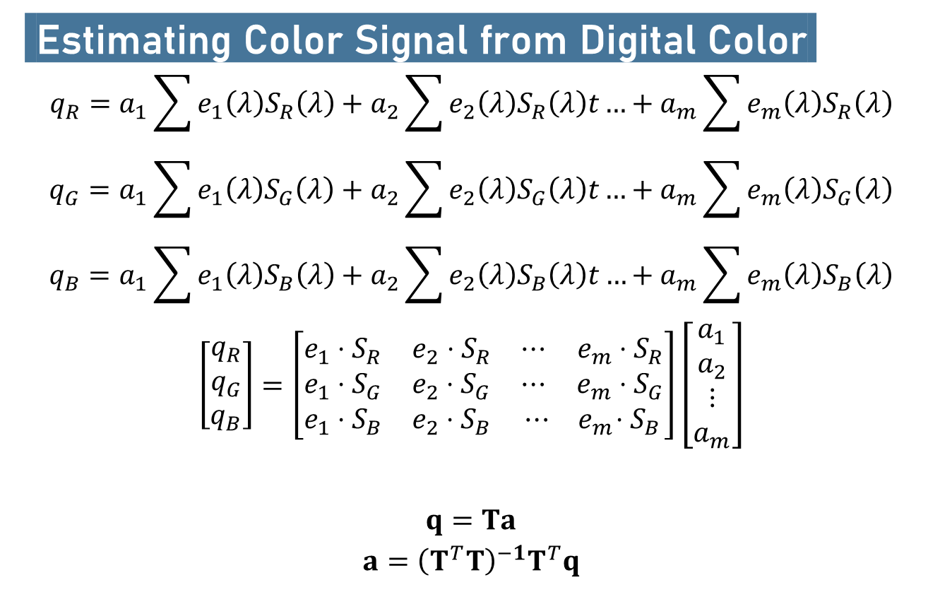
Methodology
Estimating Color Signal from Digital Color.
$$q_{R}=a_{1}\sum{e_{1}\left(λ\right)S_{R}\left(λ\right)}+a_{2}\sum{e_{2}\left(λ\right)S_{R}\left(λ\right)t}…+a_{m}\sum{e_{m}\left(λ\right)S_{R}\left(λ\right)}$$
$$q_{G}=a_{1}\sum{e_{1}\left(λ\right)S_{G}\left(λ\right)}+a_{2}\sum{e_{2}\left(λ\right)S_{G}\left(λ\right)t}…+a_{m}\sum{e_{m}\left(λ\right)S_{G}\left(λ\right)}$$
$$q_{B}=a_{1}\sum{e_{1}\left(λ\right)S_{B}\left(λ\right)}+a_{2}\sum{e_{2}\left(λ\right)S_{B}\left(λ\right)t}…+a_{m}\sum{e_{m}\left(λ\right)S_{B}\left(λ\right)}$$
$$\left[\begin{matrix}q_{R} \\ q_{G} \\ q_{B}\end{matrix}\right]=\left[\begin{matrix}e_{1}⋅S_{R} & e_{2}⋅S_{R} & ⋯ e_{m}⋅S_{R} \\ e_{1}⋅S_{G} & e_{2}⋅S_{G} & ⋯ ⅇ_{m}⋅S_{G} \\ e_{1}⋅S_{B} & e_{2}⋅S_{B} & ⋯ { ⅇ}_{m}⋅S_{B}\end{matrix}\right]\left[\begin{matrix}a_{1} \\ a_{2} \\ ⋮ \\ a_{m}\end{matrix}\right]$$
$$q=Ta$$
$$a={\left(T^{T}T\right)}^{−1}T^{T}q$$

Slide 5
Background
Using Principal Components Analysis (PCA), an extensive ensemble can be reduced in terms of its dimensionality so that a few eigenspectral can closely represent the spectral reflectance of an input digital color. In this activity, a high-dimensional information shall be derived using three digital numbers of RGB in a technique called spectral super-resolution. The transformation matrix shall be calculated from the Munsell color chips ensemble and then, we attempt to recover the spectra of 24 Macbetch color patches.

Slide 6
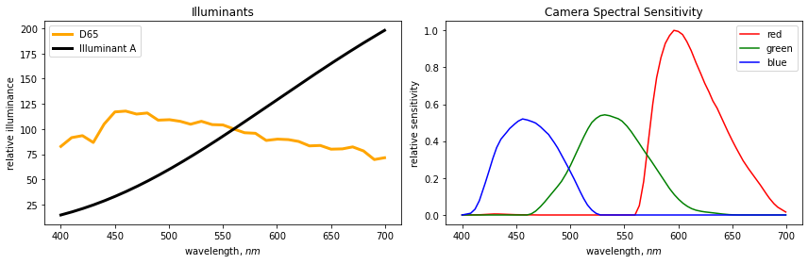
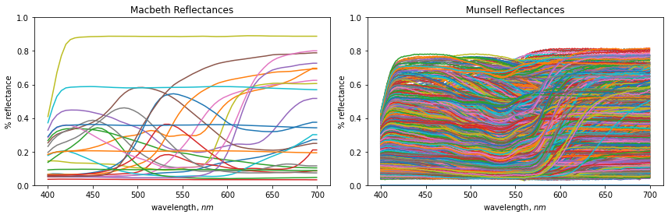

Slide 7
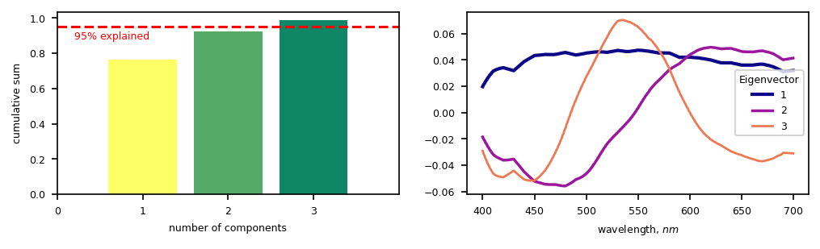
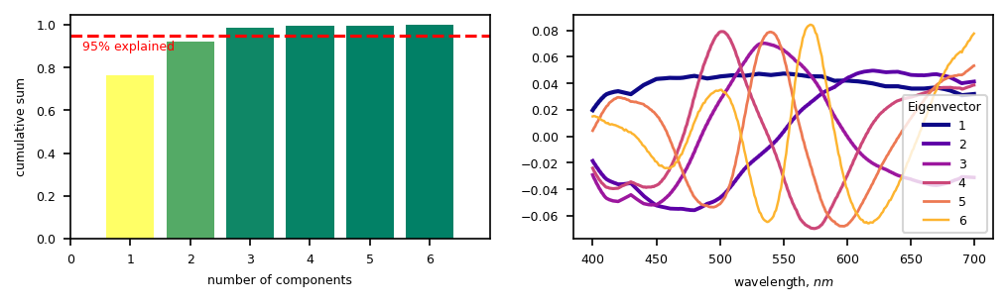

Slide 8
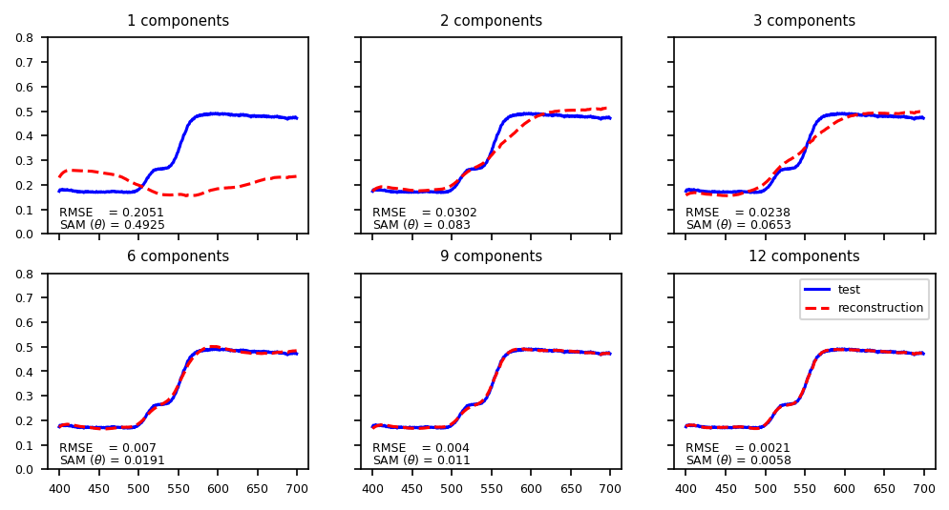

Slide 9
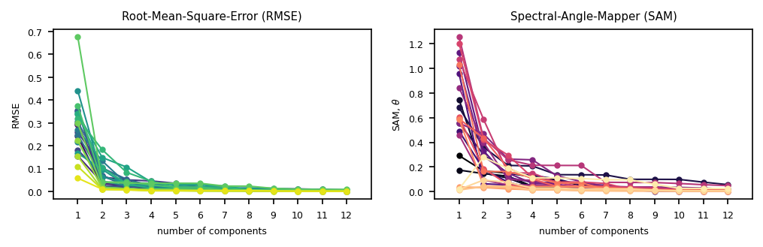
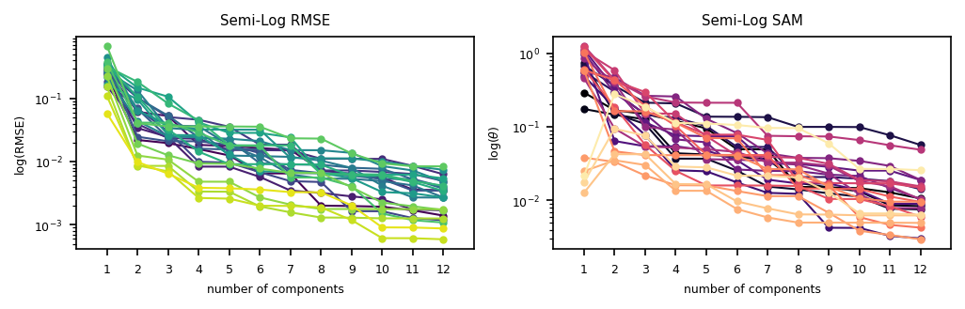
Testing Macbeth

Slide 10
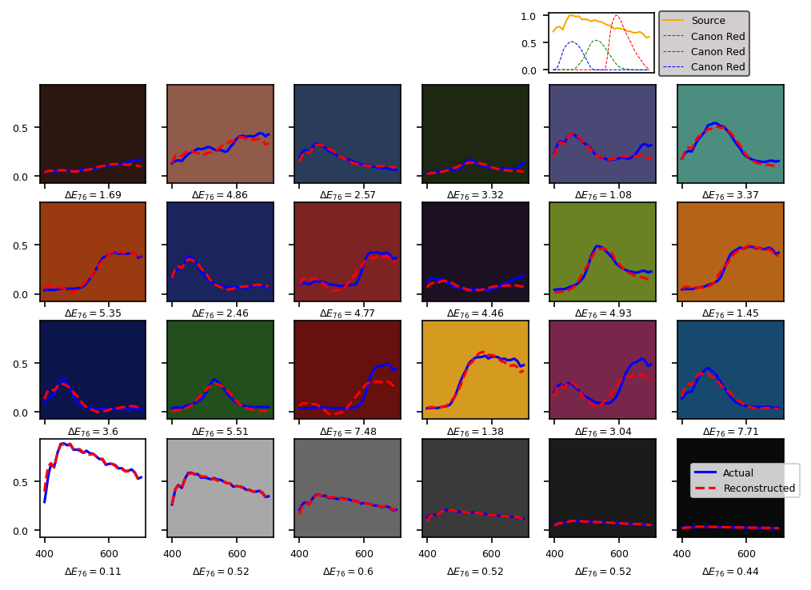
D65

Slide 11
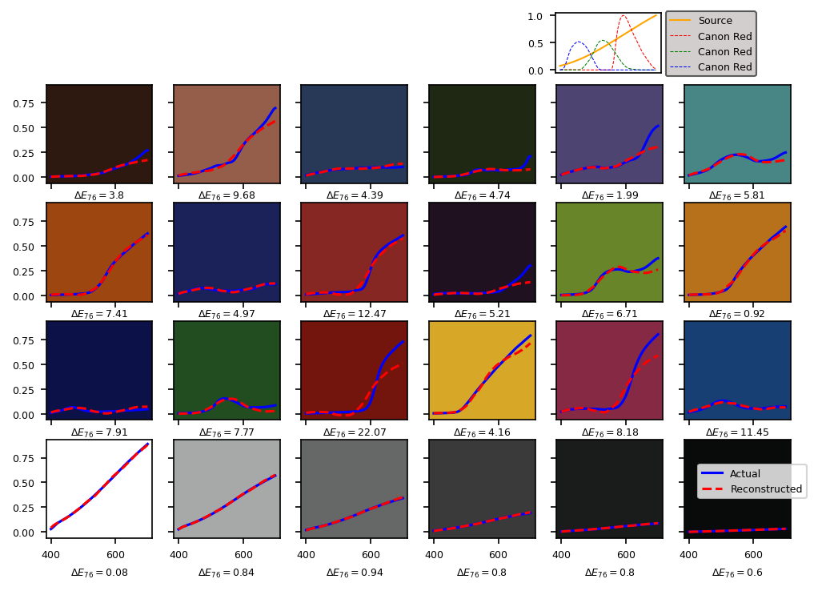
Illuminant A

Slide 12
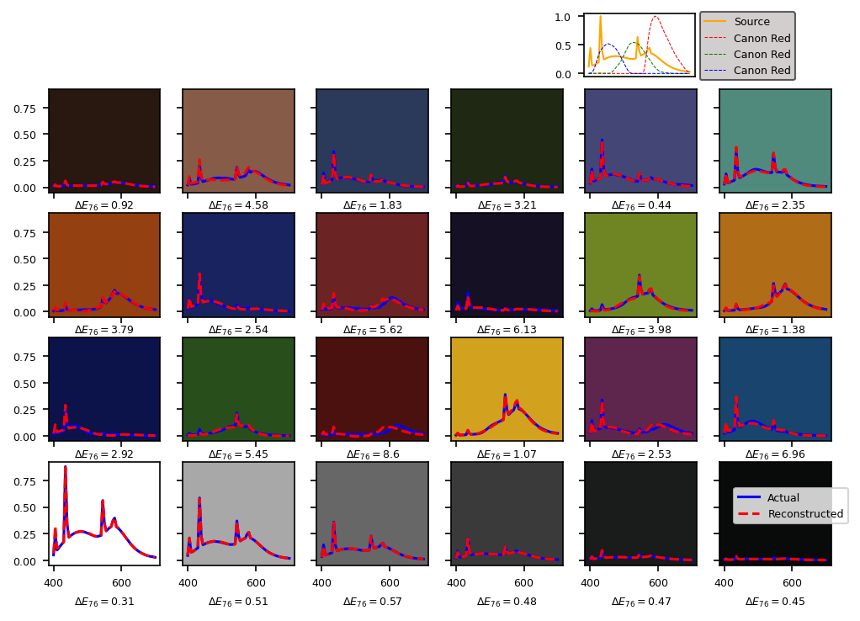
Flourescemt

Slide 13
